Slide 1

React Native Brownbag

Slide 2
What is React Native?
React Native lets you build mobile apps using only JavaScript. It uses the same design as React, letting you compose a rich mobile UI using declarative components.
https://facebook.github.io/react-native/

Slide 3

Why React Native?
Cross platform
Open source
Reusable component
Styling using CSS
Lots of third party npm packages
Live/Hot reloading
Faster compile times

Slide 4

Common React Native components?
View
Text
StyleSheet
Image
TouchableOpacity
Icon

Slide 5

PLATFORM SPECIFIC STUFF
Import { Platform } from ‘react-native’
<View style={ Platform.OS == 'ios’ ? styles.Ios : styles.Android }>

Slide 6

Who’s using React Native?
https://facebook.github.io/react-native/showcase

Slide 7

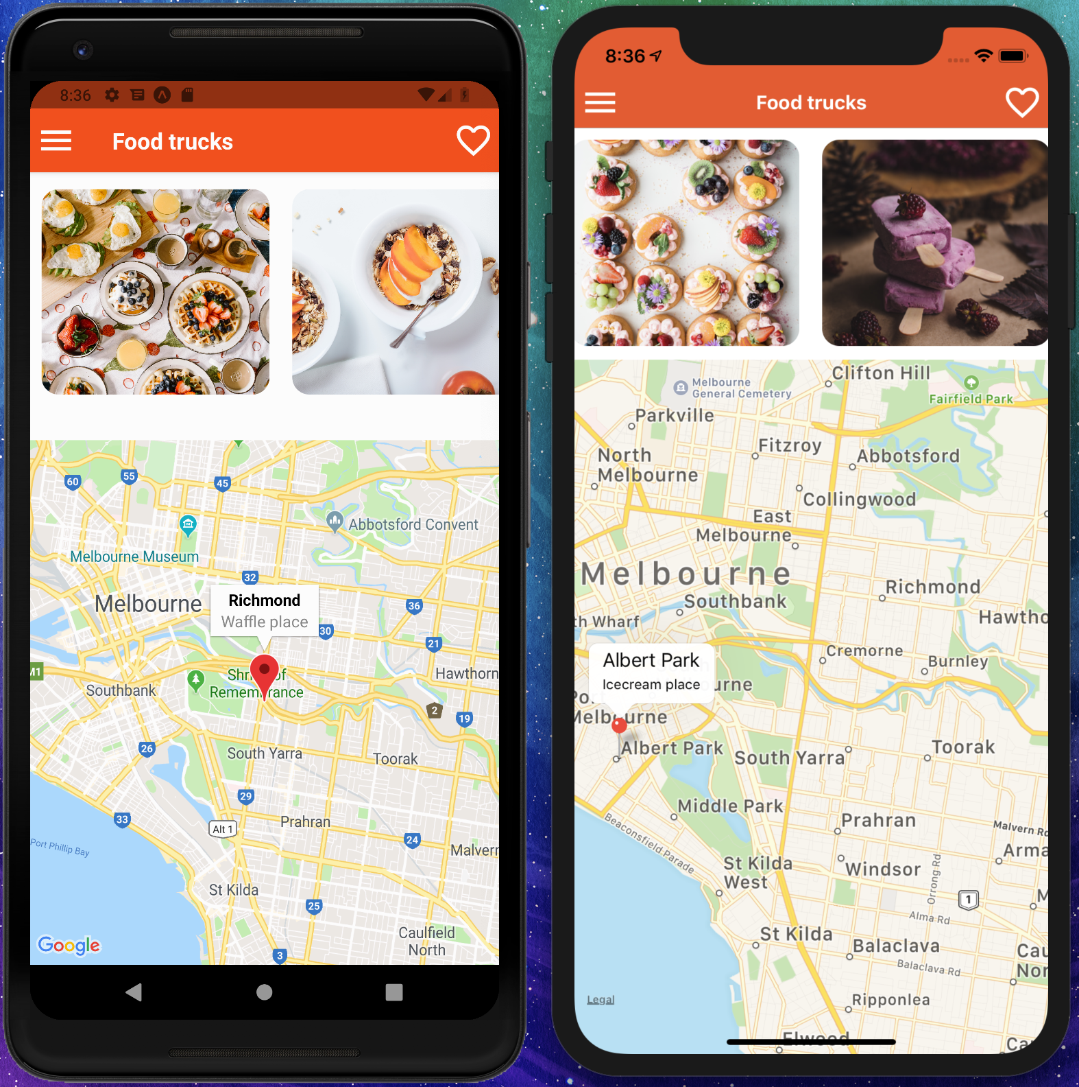
Let’s Get Started
https://github.com/Chandankkrr/react-native-brownbag

